Slide 1



Create space Help make room for all attendees. Move to the front of the room and the center of the row.
l Share your feedback Complete the in-app session survey following each session.
l
Join us at the Bash!
Network with peers while enjoying great music and good food.
Notes:
Basic one column slide.
This slide can also be used as a NASCAR SLIDE, where we want to show multiple partner/client logo or the like.

Slide 3
Laboratory stewardship: demonstrating the value of clinical laboratory medicine
Andrew Fletcher, MD; Paul Lewis, MD; Sachin Gupta, PhD
ARUP Laboratories, BayCare Health System
Notes:
TITLE SLIDE: Right-click image to replace.
**Slide not built in master slides due to the ability to swap out images.

Slide 4

Laboratory Stewardship: Demonstrating the Value of Clinical Laboratory Medicine
Andrew Fletcher, MD, CPE, MBA
Medical Director, Consultative Services, ARUP Laboratories
Notes:
TITLE SLIDE: Right-click image to replace.
**Slide not built in master slides due to the ability to swap out images.

Slide 5

AGENDA
Background
Interventions
Downstream Impact

Slide 6

Background
13 billion test performed
3 most significant causes of patient harm:
Ordering the wrong test
Failing to retrieve a test result
Misinterpreting a test result
70% decisions based
10–30% unnecessary
Notes:
13 Billion tests performed in US each year
Approximately 70% of downstream decisions based on lab results (Forsman RW. The value of the laboratory professional in the continuum of care. Clin Leadersh Manag Rev. 2002;16(6):370-3.)
10-30% of lab tests are either unnecessary or inappropriate
3 most significant causes of patient harm
Ordering the wrong test
Failing to retrieve a test result
Misinterpreting a test result

Slide 7

Trends in Healthcare
Radiology Utilization Management
Blood Utilization
Laboratory
Stewardship
Antimicrobial Stewardship
Pharmacy Utilization Management
Notes:
Laboratory Stewardship?

Slide 8
Laboratory Stewardship Programs
1/3
Success Factors
of labs have a stewardship program
Data Analysis
Formal Governance
Evidence-Based Recommendations
IT Engagement and Support
Project Management
Measurement and Reporting
1/2
of those labs have a productive and progressing committee

Slide 9
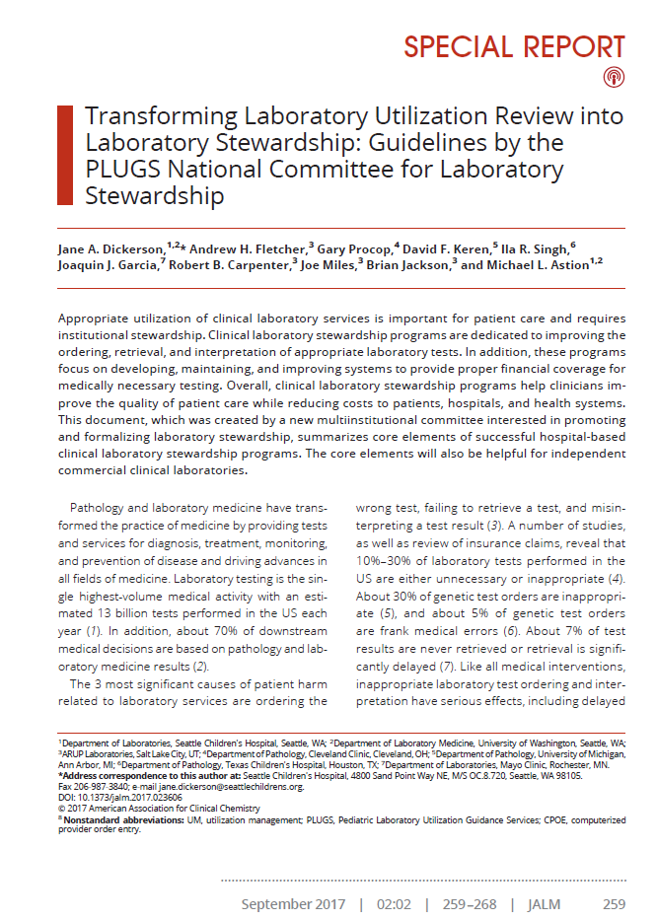

NCLS Publication
http://jalm.aaccjnls.org/content/2/2/259
Notes:
Watch for more information about NCLS in the upcoming conference meetings tomorrow and Friday

Slide 10
AGENDA
Background
Interventions
Downstream Impact

Slide 11

Interventions
LABORATORY STEWARDSHIP
Two Initial areas of Focus:
Reference test formulary
Creation & Implementation
In-House Testing
Daily recurring labs
Inappropriate test intervals

Slide 12


Test Formulary
LABORATORY STEWARDSHIP
Review
Eliminate
Review
all sendout testing performed in 1 year
test listing in menu if ordered <4 times in 1 year
remaining test on menu to see if reasonable
Notes:
Initial Attempt: Three Tier System
Tier 1 Tests orderable by any physician
Tier 2 Tests with restrictions (only certain physicians)*
Tier 3 Test not approved. Cannot be ordered*.
Current State: Facility Specific Formulary based on ordering patterns
1. Review all send out testing performed in 1 year.
2. Eliminate test listing in menu if ordered <4 times in 1 year.
3. Review remaining test on menu to see if reasonable
(1,25 Dihydroxy Vitamin D?)
4. Low volume testing (not on menu) still performed upon review for
appropriateness*

Slide 13
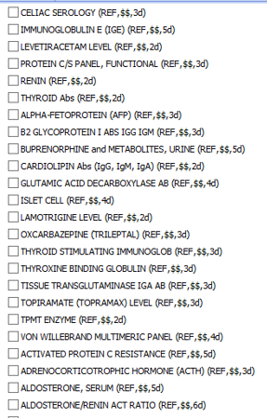
EMR Optimization

Slide 14
Interventions
LABORATORY STEWARDSHIP
Two Initial areas of Focus:
Reference test formulary
Creation & Implementation
In-House Testing
Daily recurring labs
Inappropriate test intervals

Slide 15

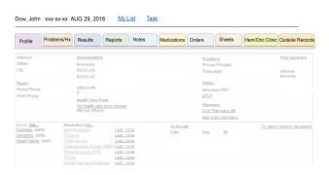
Intervention Methods
LABORATORY STEWARDSHIP
Proactive
Reactive
Appropriate order sets
Order management
Preference list management
Duplicate alerts
Best Practice Alerts
!
Notes:
There are different ways that we can design an intervention. Broadly, we have reactive and proactive approaches. The right approach is often a combination of both.
Pop-ups have their purpose, no doubt about it, but pop-fatigue is a real thing. To mediate this while also being able to impact test utilization, we need to be thinking about what can be proactively done to result in pop-ups not being required.
Think about the physician work flow to ensure long term sustainability of your utilization improvement efforts

Slide 16
AGENDA
Background
Interventions
Downstream Impact

Slide 17
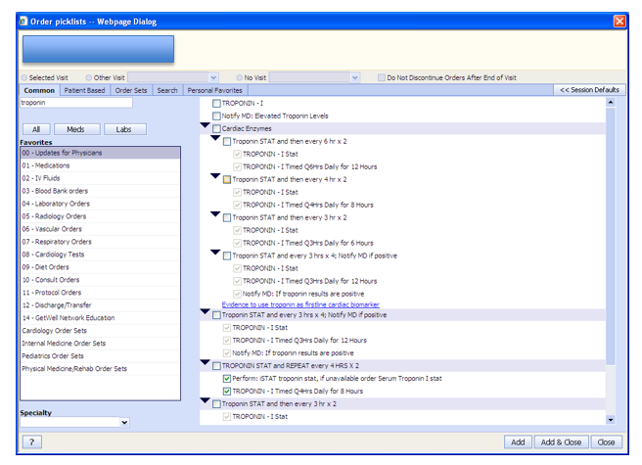
DOWNSTREAM IMPACT
Troponin Orders and Chest Pain LOS

Slide 18


DOWNSTREAM IMPACT
Troponin I
2,965
3,587
4,410
Identify order mechanisms that drive the repeat interval
Improve the time-to-decision by improving the test interval by up to 3 hours
Modify the repeat time to be 3-6 hours after

Slide 19
AGENDA
Background
Interventions
Downstream Impact

Slide 20
Thank you!
Andrew Fletcher, MD, CPE, MBA
Medical Director, Consultative Services, ARUP Laboratories
Notes:
TITLE SLIDE: Right-click image to replace.
**Slide not built in master slides due to the ability to swap out images.

Slide 21
Laboratory stewardship: demonstrating the value of clinical laboratory medicine
Paul Lewis, MD, FAAFP, CPE, CPHIMSS, Director Evidenced Based Medicine & Quality
Sachin Gupta, MT (ASCP), PhD, MBA, Laboratory Quality and Informatics Lead
BayCare Health System

Slide 22

BayCare Health System
BayCare is a leading not-for-profit health care system that connects individuals and families to a wide range of services at 15 hospitals and hundreds of other convenient locations throughout the Tampa Bay and West Central Florida regions.

Slide 23


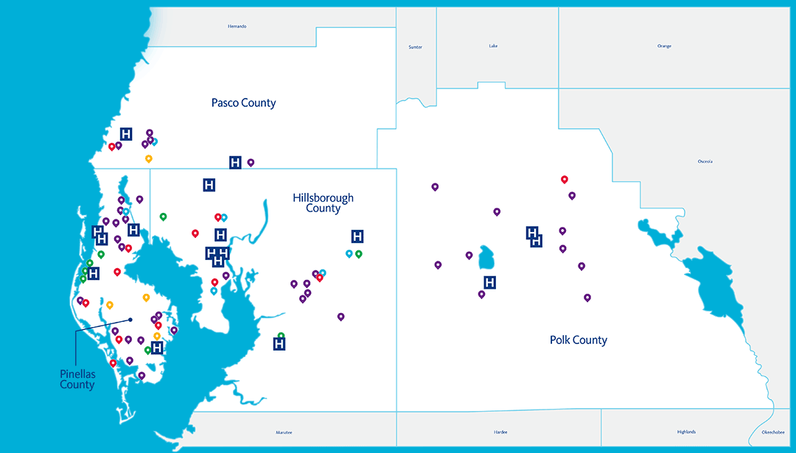
About Us
$4.2 Billion
Revenue
28,400
Team Members
36%
Market Share
AA2
Credit Rating

Slide 24
Objectives
Understand what the effect is of using an evidence-based clinical decision support on the yield of CT Pulmonary Angiograms for acute pulmonary embolism in the emergency department.
Understand the value of multi-disciplinary collaborations and Discern rules/alerts to improve laboratory test utilization.
Identify several techniques for leveraging Clinical Decision Support functionality & Data to improve the utilization of diagnostic testing

Slide 25
CDS Request
Lab Stewardship group evaluation and prioritization
Escalated to Lab Medicine Collaborative
Approved by other committees, if required
Approved by CDS Committee
Laboratory Rules & Alerts request process

Slide 26

Pulmonary Embolism (PE)
Pulmonary embolism (PE) is a sudden blockage in a lung artery caused by the formation and movement of blood clot generally originating in a leg vein (deep vein thrombosis, DVT).

Slide 27

What is Pulmonary Embolism

Slide 28
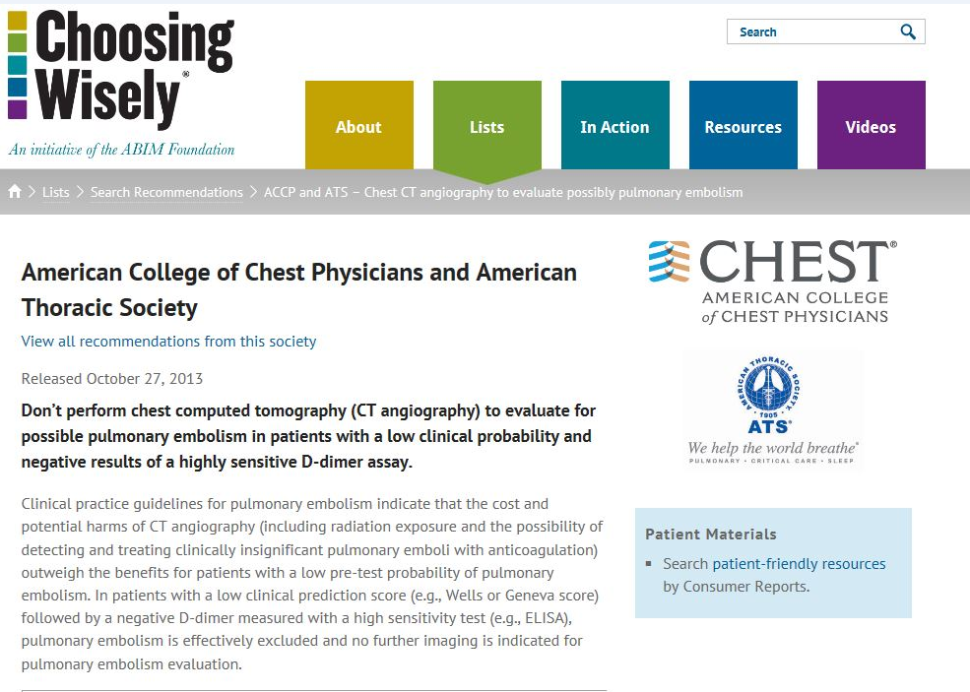
Notes:
Risks of over- CTPAs (AKI, radiation, costs)

Slide 29
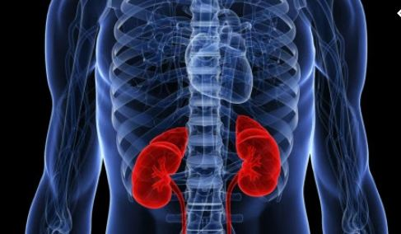
Potential Complications of a CTPA
Contrast Induced Renal Injury 2-12%
Radiation Exposure
Allergic Reaction
False Positives
Notes:
The use of CTPA to evaluate suspected PE has increased drastically.
• While CTPA is generally safe, some
risk exists.
1. renal injury from contrast
2. radiation exposure
3. false positive interpretations leading to
unnecessary anticoagulation of patients.
4. Incidental findings creating low value care

Slide 30
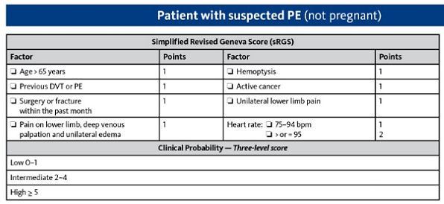
Pulmonary Embolism Risk Assessment
Simplified Revised Geneva Score in conjunction with the PERC and D-Dimer to determine need for further testing
BayCare Medical Standard for evaluating an ED patient with suspected pulmonary embolism relies on determining the pretest probability using evidence-based clinical decision rules
Notes:
In suspected acute PE, the pretest probability is determined using evidenced – based standardized clinical decision rules (CDR) in order to risk stratify patients and guide decisions about imaging for PE.

Slide 31
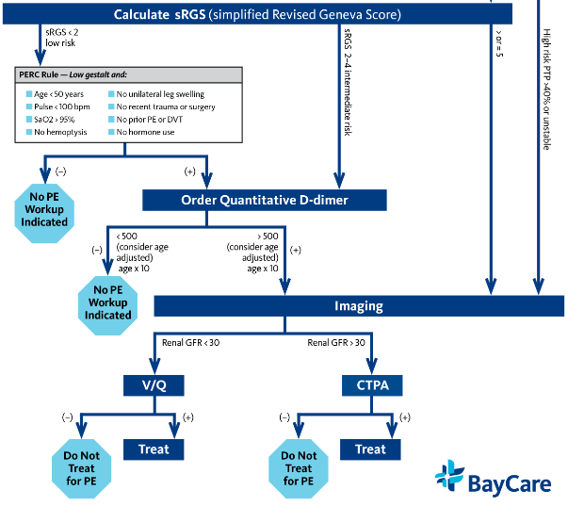

Slide 32

Positive Yield for PE
National Benchmark: ˜10%
CHEST 2014
Notes:
Define positive yield
Minimal change in data with education
Also unable to risk stratify so unable determine pretest probability – doctors not recording or sometimes in their notes
National benchmark is 10% (top performing institutions)

Slide 33
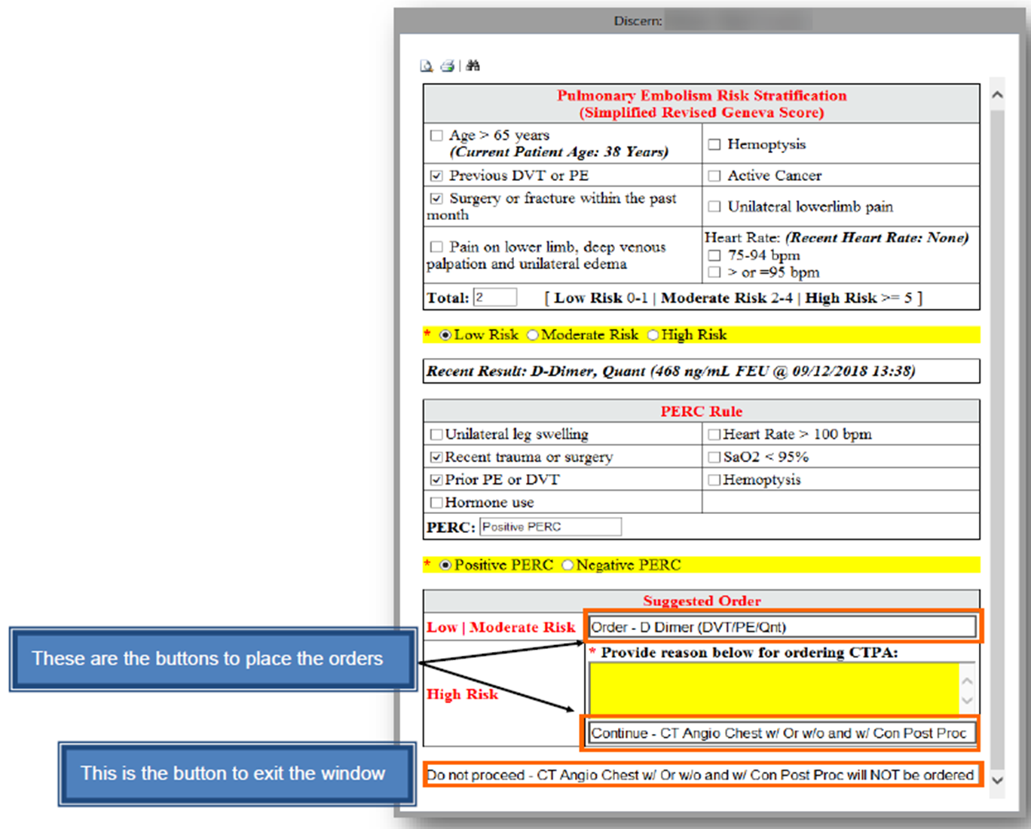

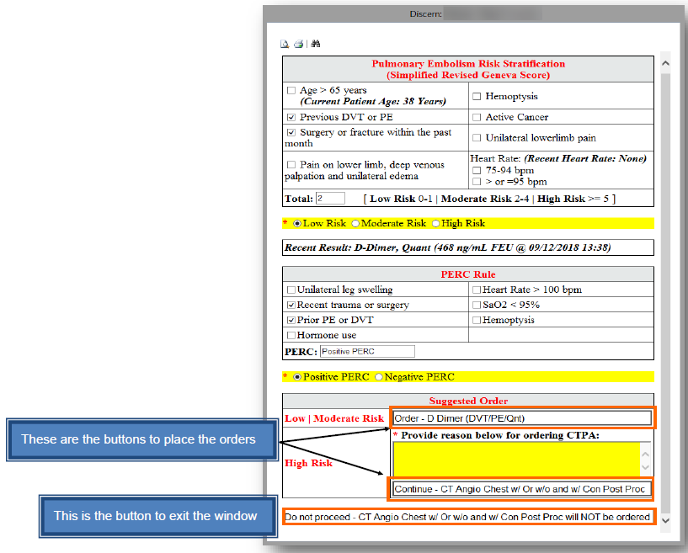
PE Risk Assessment Alert implemented in EMR
Risk stratification patient for pulmonary embolism using
PERC and simplified Revised Geneva Score (sRGS)
High Risk: Order CTPA
Moderate Risk: Order D-Dimer. No CTPA if negative
Low Risk: Order D-Dimer.
No CTPA if negative
Notes:
Rules triggered whenever ordering a d-dimer OR CTPA radiographic study ---also Created auto-text for ED Docs

Slide 34
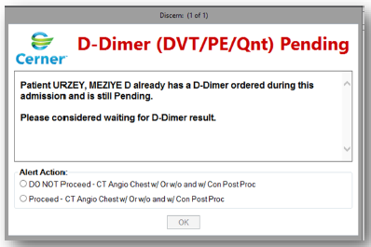
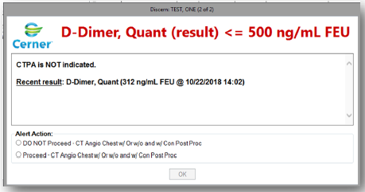
Notes:
Provide clinical guidance with alerts – used 500 as a cutoff versus age adjusted

Slide 35
Project Timeline
Data Analysis
Standards approved by ED Collaborative
Re-Education and Pocketguide in ED
1676 days
Approval of CDS alert
1311 days
Pilot at SAH ED
945 days
Go-Live (All EDs)
338 days
2019
277 days
2015
2016
2017
2018
2019
246 days
Today
2015
Notes:
Dr. Gallego

Slide 36
CDS Alert Volumes
Notes:
Dr. Gallego

Slide 37
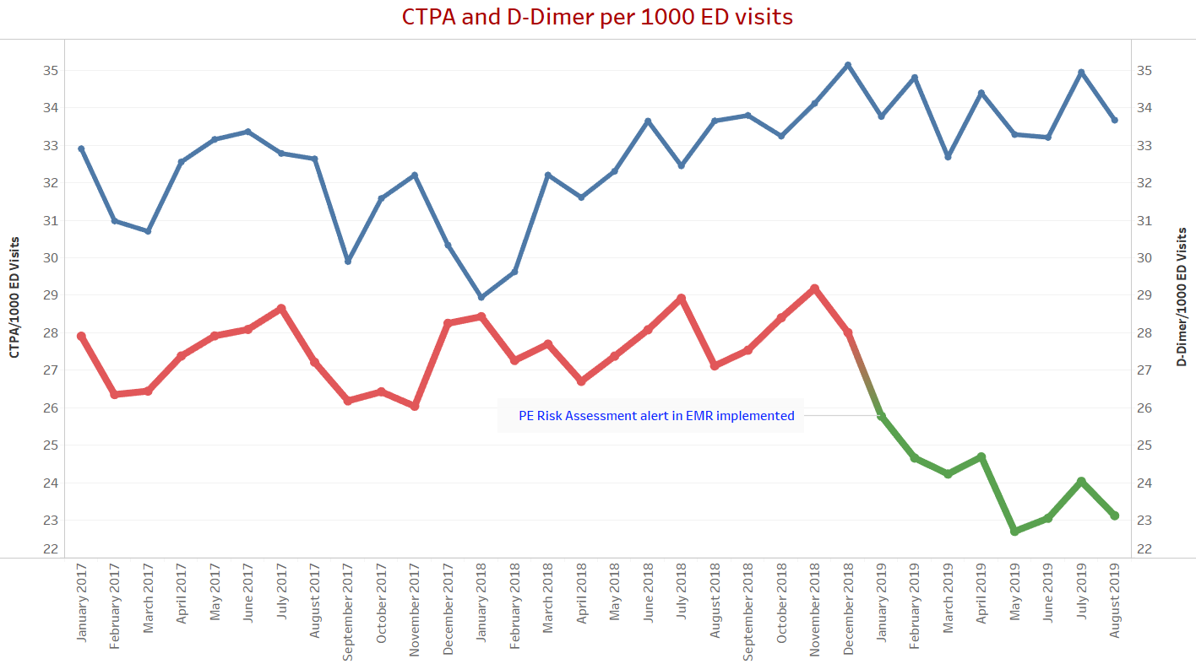
12% reduction in number of CTPAs
220 fewer CTPAs/month
Notes:
Cost savings flying in animation

Slide 38

Cost Savings
Cost per CTPA= $648*
Cost Savings: $142,560 / month
$1.71 Million / year
*Karan Verma et al. Resp Pract Thromb Haemost 2017. 1:57-61 Cost-minimization analysis of venous thromboembolism diagnosis: Comparison of standalone imaging with a strategy incorporating D-dimer for exclusion of venous thromboembolism
Notes:
Dr. Gallego

Slide 39
Positive Yield for PE
National Benchmark: ˜10%
Notes:
Discuss how we monitor physician level and ED level data
Continuous improvement

Slide 40
Number of CT Angiograms on Negative D-Dimer orders
Notes:
Discuss NPV of D-Dimer 99% in low and moderate risk patients

Slide 41
Value-Based Test Utilization
Earlier: Fee-For-Service
Now: Value Based Care
Laboratory
Appropriate Utilization
Value of Lab Results
Operational Efficiencies
Provider
Patient Safety/Care
Improved Outcomes
Lower HealthCare Costs
Performance Improvement
&
Analytics
CLINICAL VALUE

Slide 42
Clostridium difficile (C. diff) Testing
Inappropriate specimen
Repeat testing
Colonization detection
Problems
Laboratory
Infection Prevention
Pharmacy
ID Physicians
IS
Team

Slide 43
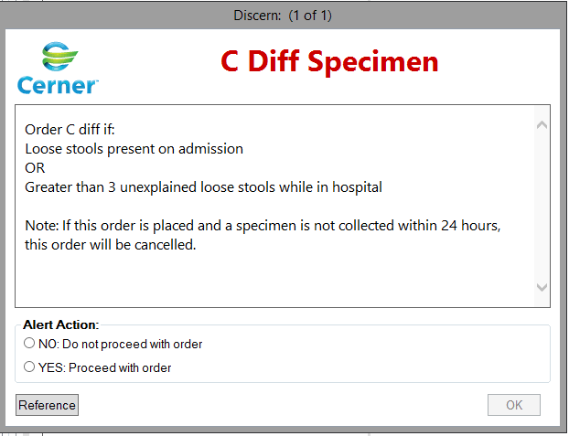
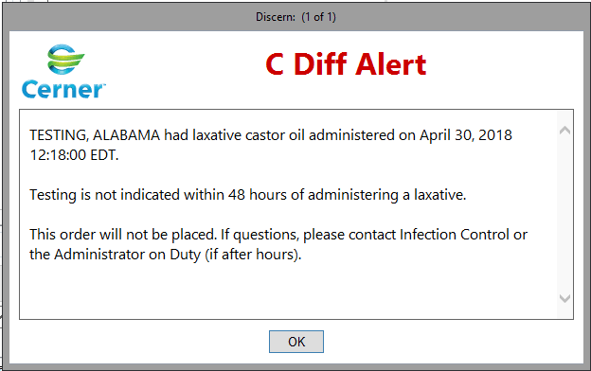
C. diff PCR (On Admission and Laxative use) Discern Alert

Slide 44
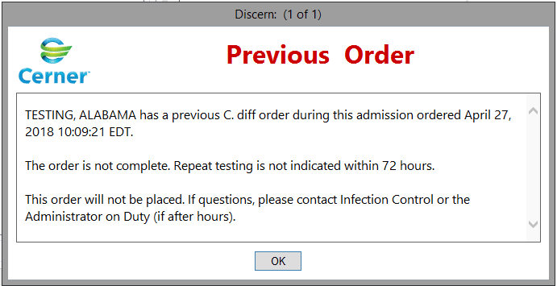
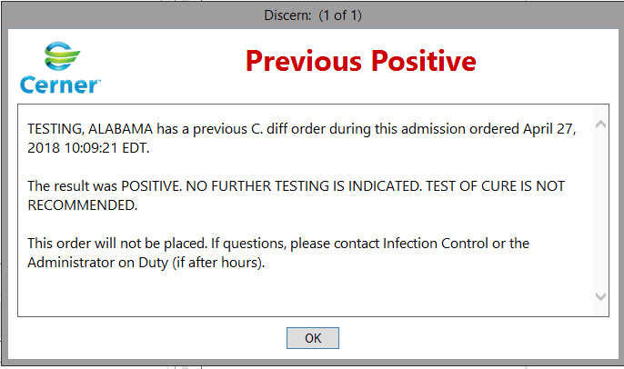
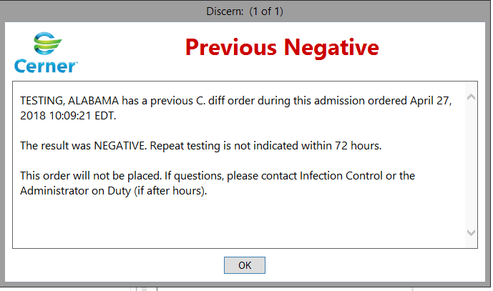
Notes:
Governance approval
Customer Buy-in
Multi-disciplinary collaboration come in
Support from leadership
Talk about MRSA discern alerts

Slide 45
Reduction in C. diff duplicate orders
C. Difficile Rates (Hospital Onset)
Notes:
Change font color from red to yellow

Slide 46
Cost savings (4 Years)
 | C-Diff PCR | MRSA PCR
Cost Savings (Testing) | $ 100,000 | $ 160,000
Cost Savings (Patients) | 1 million | 1.6 million
Notes:
In 5 years
Patient savings: 1.5 million years over 5 years
MRSA: 2 million

Slide 47
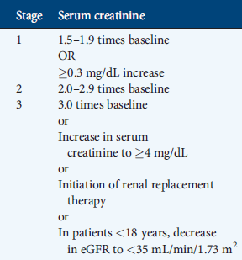
KDIGO Guidelines for Acute Kidney Injury
KDIGO (Kidney Disease Improving Global Outcomes) are widely accepted evidence-based guidelines for AKI diagnosis
Physician recognition of AKI remains poor
inability to apply criteria consistently in routine hospital setting
limited clinical awareness
lack of EMR identification/flagging
Kidney Disease Improving Global Outcomes. VOLUME 2 | ISSUE 1 | MARCH 2012

Slide 48
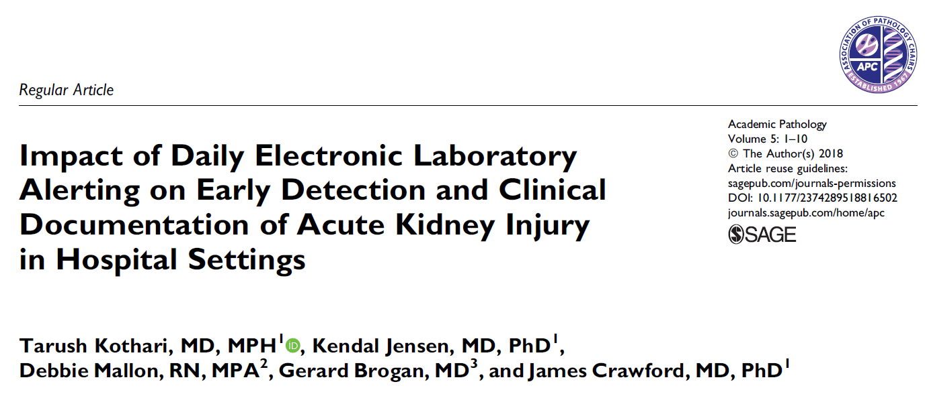
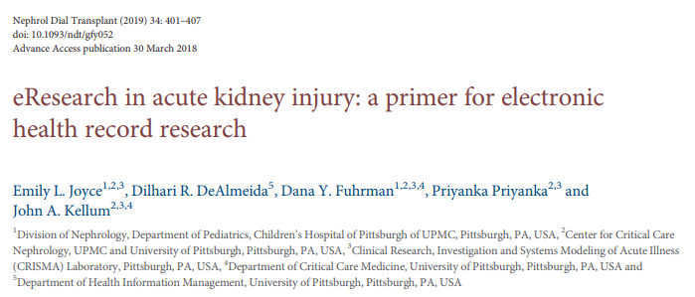
A multifactorial intervention comprising daily laboratory alerting and education of physicians, nurses, and clinical documentation improvement specialists led to increased recognition and clinical documentation of acute kidney injury.
Real-time AKI alerts with potential integration of additional clinical variables
EHR Identification decreased mortality, decreased LOS (0.3 days) and decreased dialysis (2.7%)

Slide 49
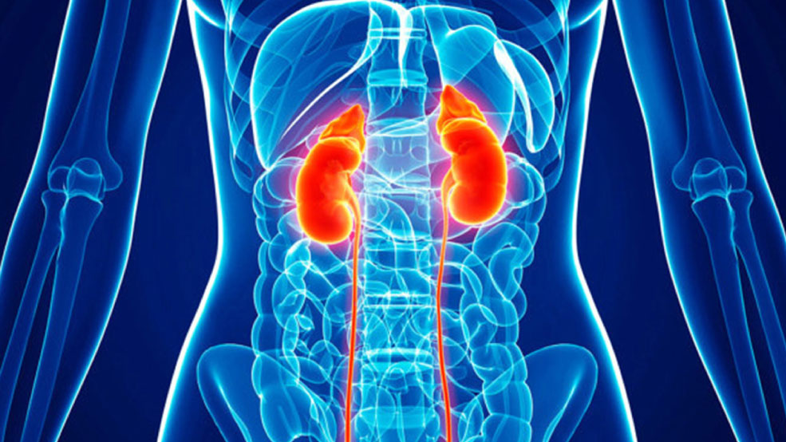
2018 BayCare Inpatients
Based on KDIGO Guidelines
Discrepancy between actual AKI and coded diagnosis
All Patients | 56%
Normal Creatinine (<1.3 mg/dl) | 84%
OPPORTUNITY

Slide 50
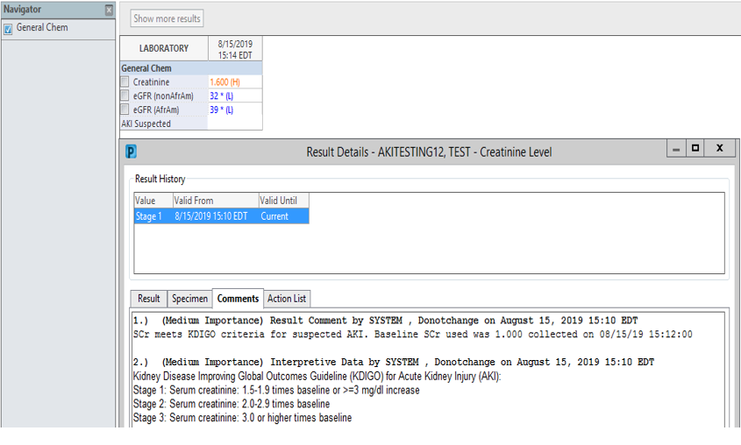
“AKI Suspected” results show up here
Baseline result value to calculate “AKI Suspected” results show up here
Reference for definitions of different AKI stages

Slide 51

*15% providers are uncertain about which test to order
** Test names are confusing
Hepatitis A Total Ab (IgG and IgM)
Hepatitis A IgM Ab (Acute)
Hepatitis A IgM Ab Reflex Hepatitis Panel (If IgM is Neg and ALT is elevated)
Hepatitis B Core IgM Ab (Acute)
Hepatitis B Core Total Ab (Immunity)
Hepatitis C Ab (Screening/Diagnostic)
Hepatitis C Ab reflex Hep C PCR (Screening/Diagnostic)
Hepatitis Panel (Hep A IgM, BsAg, B Core IgM, C Ab)
Hepatitis Panel reflex Hep C PCR (Hep A IgM, BsAg, B Core IgM, C Ab)
*Primary care physicians’ challenges in ordering clinical laboratory tests and interpreting results. J of American Board of Family Medicine, Mar-Apr, 2014
**Passiment et al, Decoding laboratory test names: a major challenge to appropriate patient care, J Gen Intern Med. 2013, 28: 453-8

Slide 52
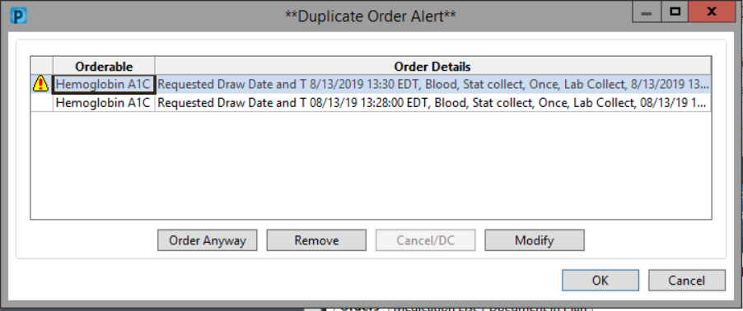
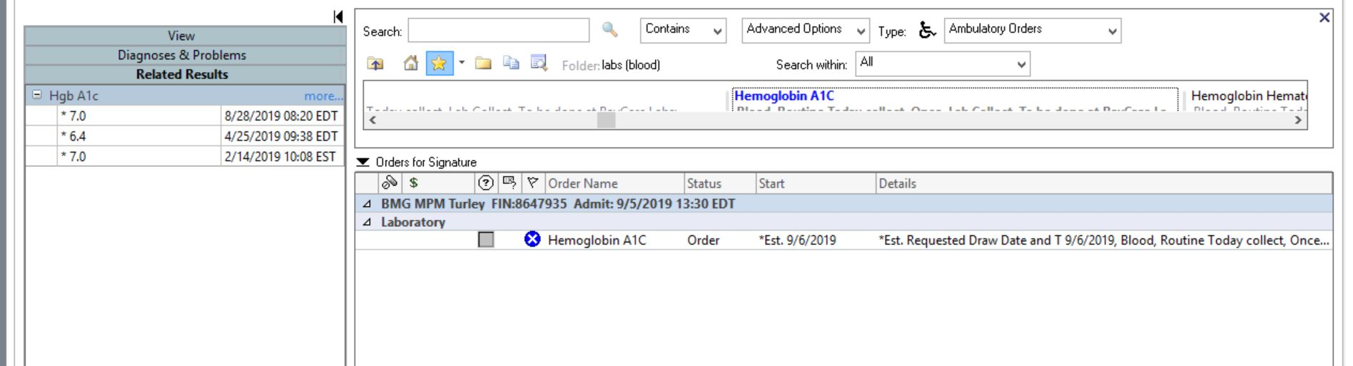
Duplicate Checking and Related Results
Related Results are displayed here

Slide 53
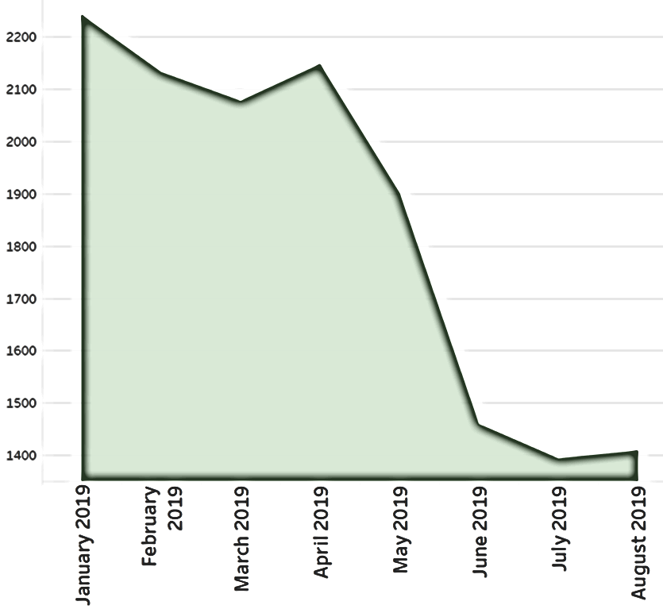
Hemoglobin A1C Order volumes
Related Results
Implemented in EMR

Slide 54
Closing Remarks/Conclusions
Only order a test if the results will change your management
CDS should not be used to solve the organization’s problems
Remember the Five Rights of CDS
Collaboration in advance/Buy-in is the KEY
Notes:
The right information (evidence-based guidance)
To the right people
Through the right channels
In the right format
At the right point in the workflow for key decision or action

Slide 55
Thank you!

Slide 56
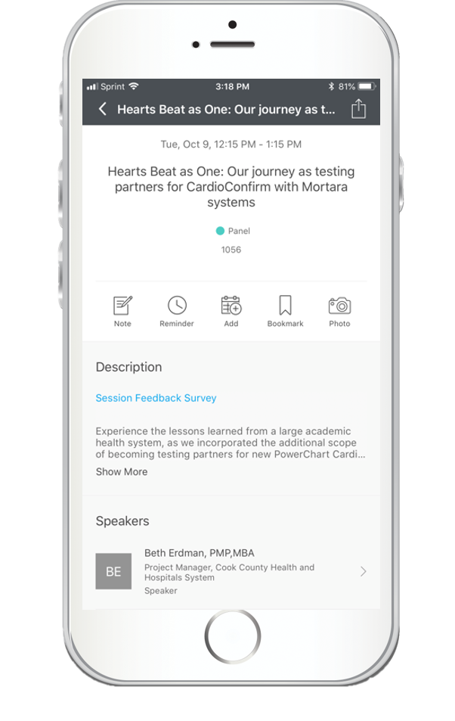
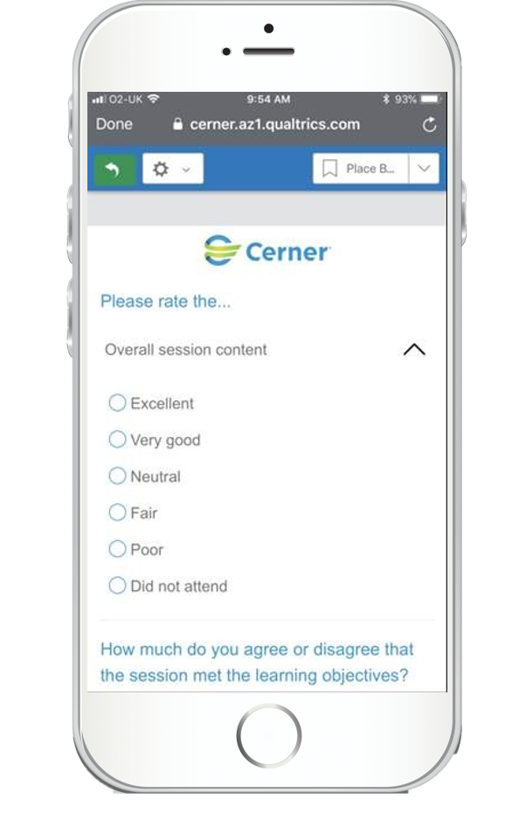
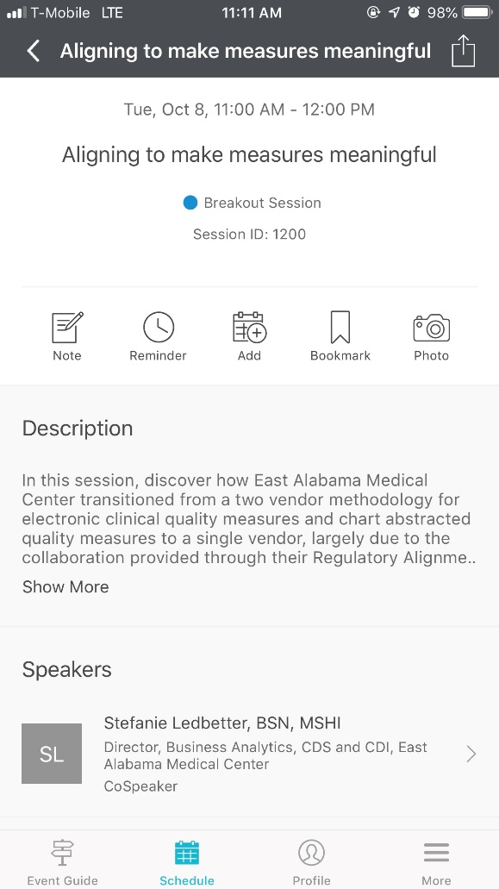


Share your session feedback

